Slide 1
A New Conversation: Empowering patients and communities Emerging learning from the Realising the Value programme
September 2016

Slide 2
A partnership programme
Nesta and the Health Foundation jointly lead a broad consortium funded by NHS England.

Slide 3
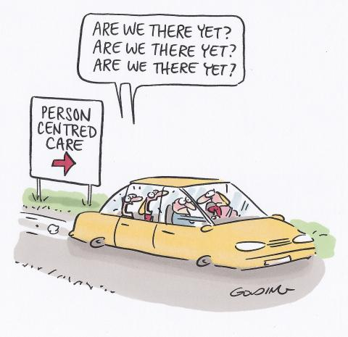
Notes:
Clearly not or we wouldn’t all be here.
Lots of work over many years – by RtV consortium partners and others – growing consensus of the challenges. Lots of inspiring examples of teams and organisations doing amazing work in this area – many of them here in the room today.
Individual teams
Organisations – Northumbria – CQC Outstanding rating
Regions – EOE Health coaching
Still on the journey (but gathering pace?)

Slide 4
!
Why now?
“One of the great strengths of this country is that we have an NHS that - at its best - is ‘of the people, by the people and for the people’.
Yet sometimes the health service has been prone to operating a ‘factory’ model of care and repair, with limited engagement with the wider community, a short-sighted approach to partnerships, and underdeveloped advocacy and action on the broader influencers of health and wellbeing.
As a result we have not fully harnessed the renewable energy represented by patients and communities, or the potential positive health impacts of employers and national and local governments.”
NHS Five Year Forward View, 2014
Notes:
FYFV not the start but has been a really helpful catalyst and has certainly focused attention within the NHS on asset based approaches and on this being about communities not just individuals where much of the focus in health care has been (pcc)

Slide 5
Overarching aims
Making the Case
Realising the Value
Behaviour & culture change
Aligning the system
Communities & networks
Notes:
What RtV has set out to explore
Will talk a bit about each of these areas (briefly today), what we have been doing throughout the programme and our emerging findings.
I hope not too off-piste from my topic of ‘a new conversation with communities’ but I think these are key areas that need to be addressed if we are to start to get to that ‘new conversation’. I think what is new about this is that this is a programme of work funded by NHSE which is reaching out into communities, trying to understand how formal health and care services can engage with community approaches and with communities to create better health and wellbeing. So I may touch on some things that Andy has covered and Michael will cover after me but will try not to do this too much.

Slide 6
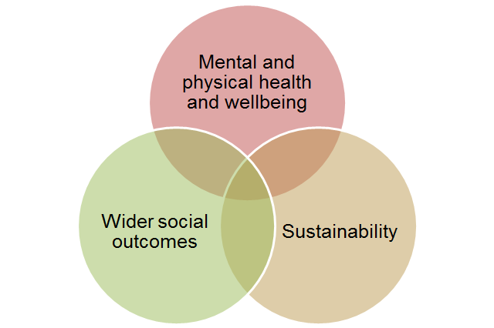
Underpinning values framework
Notes:
Don’s value’s paper and emerging values statements

Slide 7
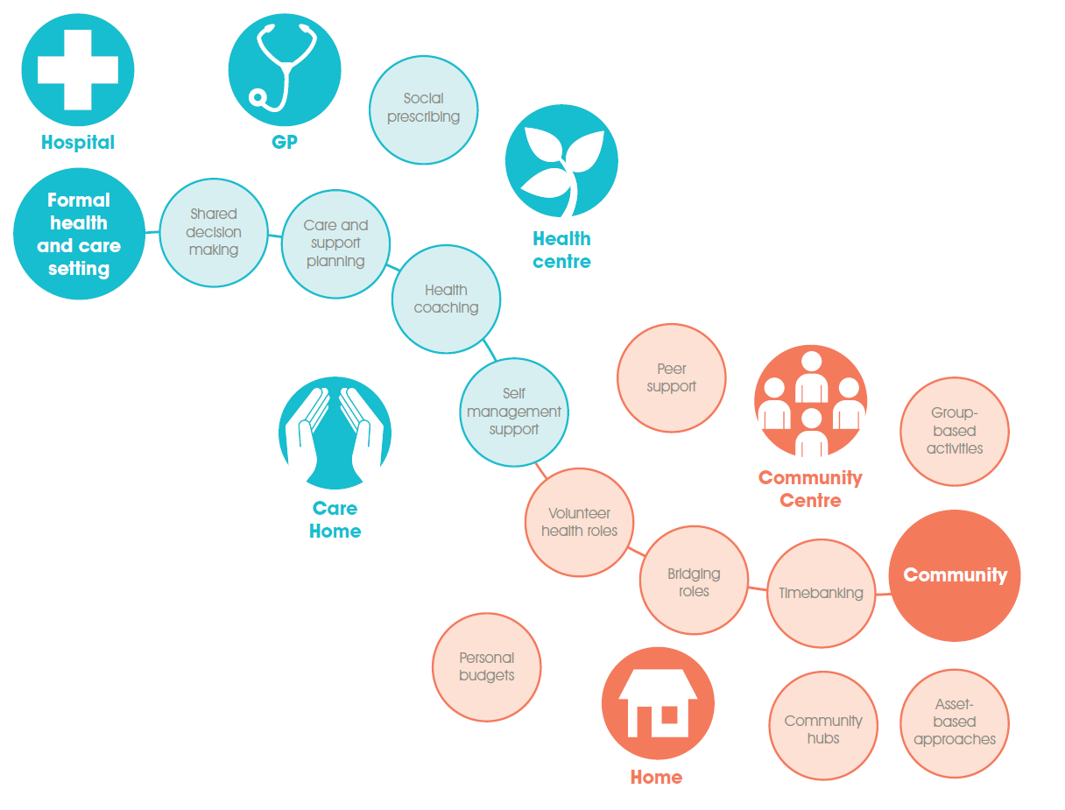
Person- and community-centred approaches
Notes:
RtV began by looking across the spectrum of approaches from (blue corner) person-centred approaches within formal health and care settings – a lot of work has been done, for example on shared decision making, developing more collaborative approaches to care and support planning (eg Year of Care partnership) and at the other end (in the orange corner) approaches which have come much more from a community base such as asset based approaches, group activities like community choirs etc.
Of course this is far from a perfect diagram as we all know person and community centred approaches don’t fit neatly into boxes (or bubbles in this case) and there is lots of cross over. In particular there is a growing interest from within the NHS on how asset based and community approaches can support or be developed within formal health services or settings – eg peer support in inpatient mental health just one example from a HF project. And health coaching is a case in point here – it appears in the blue side and yet as seen by the wide range of people and organisation represented in the room, health coaching approaches are used and developed across the whole spectrum from those like Penny’s work focusing on developing GPs and other health care professionals to use health coaching in their clinical encounters to Being Well our RtV health coaching site which is very community based and coaches are not health care professionals

Slide 8
Big Life
Health Coaching
Creative Minds
Group activities
Unlimited Potential
Asset-based
Penny Brohn
Self-management
Positively UK
Peer Support
Notes:
A key aim of RtV was to identify promising approaches from the evidence (broad evidence base) and to effectively do a ‘deep dive’ to help focus attention on the key enablers and barriers and to further build the evidence base (eg through economic modelling) in these areas – a broad brush approach would have made this difficult.
So these are our five areas and our five partner sites (have already mentioned Being Well who are here today and running a workshop later so you can find out more about how they are using health coaching to address health inequalities in their local area.
A quick point about our sites:
They are mature, established exemplars of practice.
The local partner sites are not piloting or scaling their practice as part of the programme. Instead they work with consortium partners to strengthen the evidence on person- and community-centred approaches to health and wellbeing. This includes:
identifying barriers and enablers for implementation, to impact on policy recommendations
helping to shape implementation tools (behavioural guides and economic modelling)
leading a community of interest
Ref back to FYFV slide and focus on communities – notable that all of our partner sites are community organisations. And while all work with NHS, deliver services in NHS, only one Creative Minds is based in an NHS Trust (which in itself is notable – a community organisation delivering art groups, singing groups, rock climbing and other physical activities, mosaic and sculpture classes is situated in an NHS Foundation Trust

Slide 9
Making the case

Slide 10
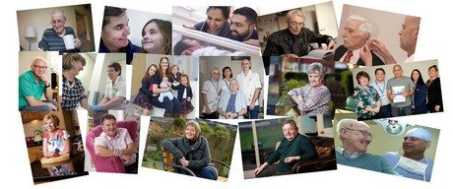
Making the case
So what do you mean by evidence?
Source: http://www.pat.nhs.uk/
Notes:
Worth reminding ourselves of the wide range of things that count as ‘evidence’.
Still a tendency to see RCT/Systematic review level evidence (and particularly evidence of financial impact or cost savings) as the only evidence.
But in this area, evidence base still developing and it is disparate and complex and sometimes difficult to quantify. Doesn’t mean we shouldn’t try and as part of RtV PPL is developing models and toolkits in each of the 5 areas. But on its own not enough.
Wide range of sources which help us build the rich picture of the evidence for a particular approach – a quick skim of the health coaching pages of the HEE EOE website is an excellent case in point:
Research – rapid evidence review
Evaluations Qualitative evaluation and case studies
Narrative stories (e.g. in one evaluation – physio about reducing her ongoing case load through supporting people more quickly to self-manage, dealing with issues more quickly but people knew they could come back if they needed)
Often used to refer to formal research evidence, systematic reviews, RCT – important but not alone sufficient – particularly in this field where we are dealing with multifaceted and complex ‘interventions’ (or often more accurately approaches) – and where there are, as I will expand on later, the evidence doesn’t still give a complete picture
Other types of evidence:
Practice – sometimes formally evaluated, often not
Patient feedback – patient surveys, FFT
And of course evidence directly from individual’s experience (patients, carers, and service users but also health care professionals on the impact working in a person centred way has had on their work, their job satisfaction etc
Will talk quite a bit about the formal evidence base in the next few slides as it is a Q that is often asked by HCP, providers, commissioners but don’t want to lose sight of the diversity of the evidence that supports the benefits of person and community centred approaches for health and care

Slide 11
Making the case
Improve health outcomes, increase confidence to self-manage, reduce social isolation
Reduce demand on services, particularly A&E and emergency admissions
Wide range of wider social benefits such as increased employment, education & increased volunteering
Notes:
Specific outcomes re health coaching from At Heart of Health and EOE evidence review

Slide 12
Health coaching – Being Well Salford
Impact
Average WEMWBS increase was 7.5 points
60% raise their self-efficacy score by at least 5 points
89% confident they can manage own behaviour (up from 51%)
Increased involvement in groups and volunteering
At follow up, wellbeing and self-efficacy is maintained.
Notes:
Who are Being Well – RtV health coaching partner site
Public Health commissioned service for people with multiple lifestyle risks
Managed by The Big Life group, but delivered by 8 Salford organisations
12-month coaching support on the participants’ terms
Goal-setting and sustainable behaviour change, one-to-one and in groups
Connecting to other activities in the area
Minister of Public Health and RSPH award winners
The Warwick-Edinburgh Mental Well-being scale was developed to enable the monitoring of mental wellbeing in the general population and the evaluation of projects, programmes and policies which aim to improve mental wellbeing.

Slide 13
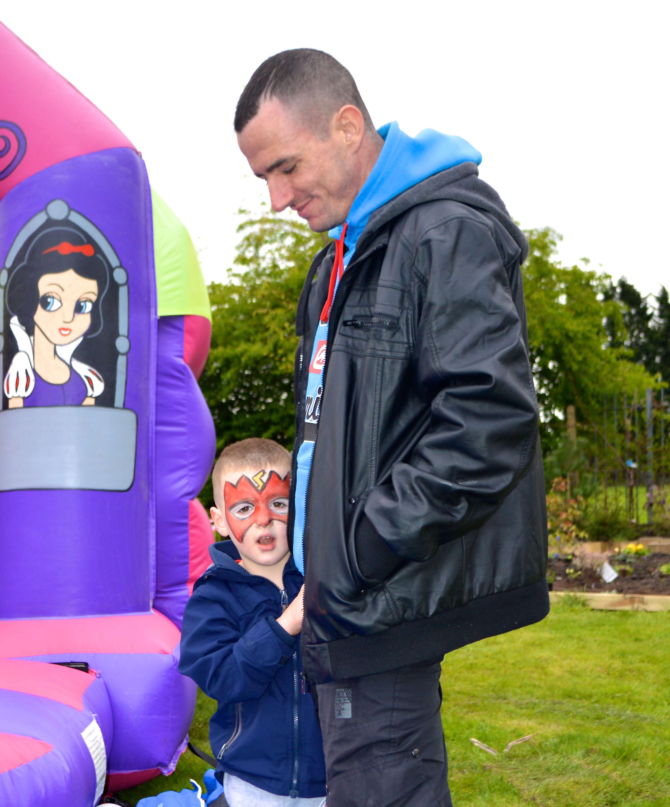
Health coaching – Being Well Salford
John’s story
I had space to talk
I could focus on what I could deal with
I dealt with it in a structured way
I felt better, as I was doing something, not just talking
I was introduced to a social approach, not another ‘service’
Notes:
And ref back to importance of people’s stories as evidence - our RtV sites told us that while the busines case is essential, it is often the evidence from people (service users, practitioners, clinicians) combined with the financial and outcome evidence that is what gets them commissioned – hearts and minds – reminder of why doing this in the first place.

Slide 14
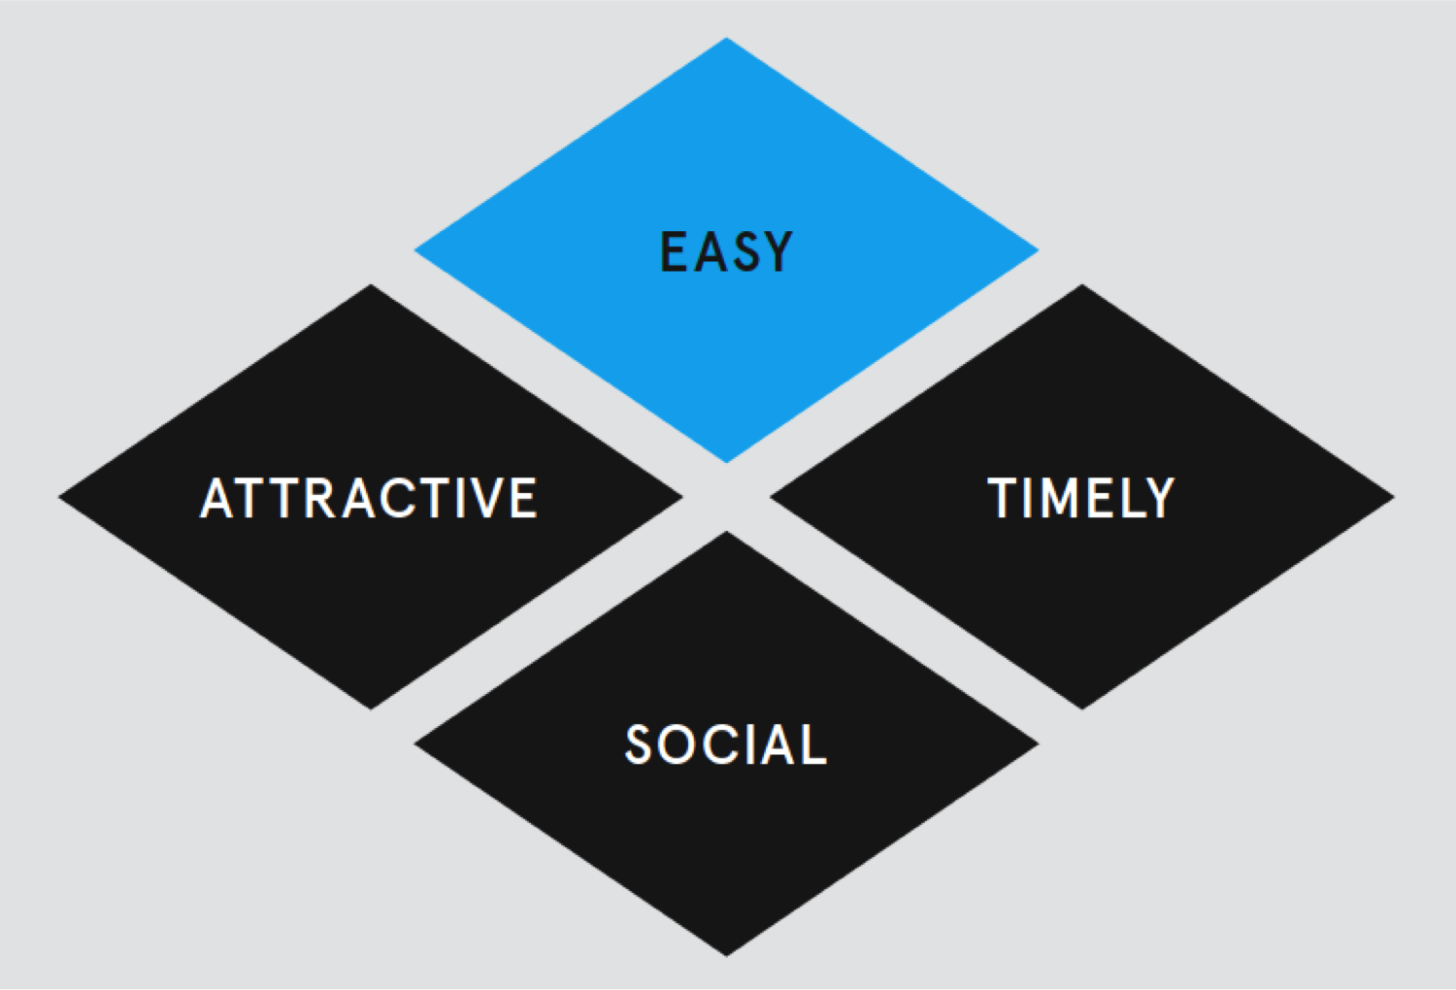
Supporting behaviour change

Slide 15
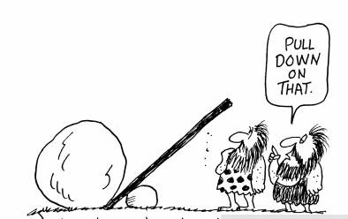
Aligning the system
Notes:
Deep in this at the moment so this slide particularly resonants with me.
Disconnect between national and local was a clear message from our work.
Context – particularly financial pressures on health services and even more so on social care – make thinking about capacity of the system to respond challenging to say the least. How do we best align work on person and community centred approaches to support this (partly goes back to making the case) – more likely to have impact that way.
Where to start? Lots has been written and recommended about how national bodies should respond.
What feels different to me now cf with 5 or so years ago is that there is lots of work going on within and between national bodies where feels they are really trying to get to grips with this. Lots of challenges ahead but think we need to recognise and find ways to encourage work that is going on:
HEE/NHS – focus on workforce and clearly articulating the knowledge, skills and competencies to support staff to work in these new ways – drawing on and learning from rich experience in health coaching, shared decision making, care and support planning – not about replacing these approaches but identifying the core elements that are common to them and making sure they are instilled in all staff regardless of where they work or their professional qualification
Also key is wider workforce issue – not just about training (skills trumps tools, attitude trumps all) – how do we harness, celebrate and encourage creative approaches led by staff themselves to tap into intrinsic motivations
Other priority areas:
Use of data, technology
Outcomes and measurement – thinking differently about value
Flowing from this, how we pay for and reward performance and what impact changes to payment system is likely to have
How we ensure this is embedded in national improvement initiatives and programmes – some work on this in new care models etc but real opportunity with NHS Improvement developing strategy etc

Slide 16
Communities and Networks
Source: Leading Networks in Healthcare, The Health Foundation 2013

Slide 17
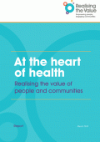
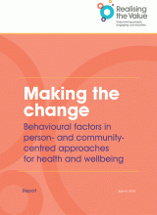
Resources and practical materials
The potential and value of P&CC
(Feb 16)
Economic tools for commissioners
Recommendations on what needs to change: on a systems level and on the ground
(Nov 2016)
Behavioural insights guides
(Mar + Sep 16)
Resource centre and practical mini-guides
(ongoing + Nov 2016)

Slide 18
Keep in touch
#realising the value / www.realisingthevalue.org.uk
info@realisingthevalue.org.uk

